Slide 1
CSC3-II: Secure Configurations For HW & SW

Slide 2
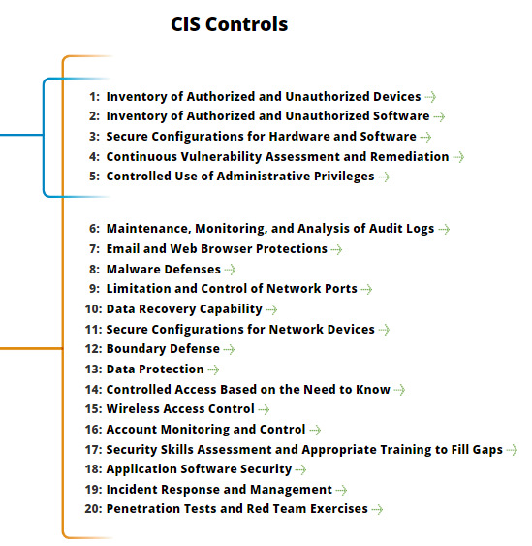
CSC3-II: Secure Configurations For HW & SW
https://www.cisecurity.org/controls/

Slide 3
CSC3-II: Secure Configurations For HW & SW
3.5: Use file integrity checking tools to ensure that critical system files (including sensitive system and application executables, libraries, and configurations) have not been altered.

Slide 4
CSC3-II: Secure Configurations For HW & SW
3.5…: The reporting system should have the ability to account for routine and expected changes; highlight and alert on unusual or unexpected alterations; show the history of configuration changes over time and identify who made the change…

Slide 5
CSC3-II: Secure Configurations For HW & SW
3.5: (including the original logged-in account in the event of a user ID switch, such as with the su or sudo command).

Slide 6
CSC3-II: Secure Configurations For HW & SW
3.5…: These integrity checks should identify suspicious system alterations such as: owner and permissions changes to files or directories; the use of alternate data streams which could be used to hide malicious activities;

Slide 7
CSC3-II: Secure Configurations For HW & SW
3.5…: and the introduction of extra files into key system areas (which could indicate malicious payloads left by attackers or additional files inappropriately added during batch distribution processes).

Slide 8
CSC3-II: Secure Configurations For HW & SW
3.6: Implement and test an automated configuration monitoring system that verifies all remotely testable secure configuration elements, and alerts when unauthorized changes occur.

Slide 9
CSC3-II: Secure Configurations For HW & SW
3.6…: This includes detecting new listening ports, new administrative users, changes to group and local policy objects (where applicable), and new services running on a system.

Slide 10
CSC3-II: Secure Configurations For HW & SW
3.6…: Whenever possible use tools compliant with the Security Content Automation Protocol (SCAP) in order to streamline reporting and integration.

Slide 11
CSC3-II: Secure Configurations For HW & SW
3.7: Deploy system configuration management tools, such as Active Directory Group Policy Objects for Microsoft Windows systems or Puppet for UNIX systems that will automatically enforce and redeploy configuration settings to systems at regularly scheduled intervals.

Slide 12
CSC3-II: Secure Configurations For HW & SW
3.7…: They should be capable of triggering redeployment of configuration settings on a scheduled, manual, or event-driven basis.
END

